Slide 1
UPPER SIXTH ARTS
GEOGRAPHY
Lesson 7
Notion of Development
Notes:
Good morning, class, and welcome to our geography lesson. I am your geography teacher, Mr Kamdem. Today we are starting Lesson 7: Notion of Development.

Slide 2
CLASS INFO
Class, Chapter and Duration
Class | Upper Sixth Arts
Chapter | Module 7: Understanding and managing contemporary environmental and development issues
Duration | 2 periods (2 × 50 minutes)
Notes:
This lesson is for Upper Sixth Arts. It belongs to Module 7: Understanding and managing contemporary environmental and development issues. We shall need 2 periods to cover it.

Slide 3
IDENTIFICATION
Lesson Identification
Topic | Current Development Issues
Sub-topic | Concept of Development
Lesson | Lesson 7: Notion of Development
Notions / Concepts | Development, economic growth, GNI, HDI, development gap, sustainable development.
Syllabus focus | Meaning of development, economic development and growth; reasons for the gap between rich and poor; economic and social criteria (HDI); classification of countries; sustainable development and ways to achieve it.
Competence | Learners are able to measure development, explain the development gap and suggest ways to achieve sustainable development.
Notes:
Our topic is Current Development Issues, and the sub-topic is Concept of Development. The key notions we shall use today are: development, economic growth, GNI, HDI, development gap, sustainable development. At the end, you should be able to do this: learners are able to measure development, explain the development gap and suggest ways to achieve sustainable development.

Slide 4

HOMEWORK CORRECTION
Correction of the Homework
Question (Lesson 6: Flooding):
Map the flood-prone areas of your town and suggest two solutions.
Notes:
Before we start the new lesson, let us correct the homework I gave you at the end of Lesson 6: Flooding. The question was: Map the flood-prone areas of your town and suggest two solutions. Take out your exercise books.

Slide 5
HOMEWORK CORRECTION
Correction: Possible Answer
Answers vary. Flood-prone areas are low valleys, riverbanks and places with blocked gutters. Solutions: clean and widen gutters, stop building on riverbanks, and plant trees upslope.
Notes:
Here is a good answer. Answers vary. Flood-prone areas are low valleys, riverbanks and places with blocked gutters. Solutions: clean and widen gutters, stop building on riverbanks, and plant trees upslope. Compare it with your own answer and correct your work in red.

Slide 6
LESSON PLAN
Lesson Plan
Correction of the homework
Objectives and recall
Real-life situation and action to take
Learning activities
Board summary
Evaluation, remediation and homework
Notes:
Here is the plan of our lesson today. First, we shall correct the homework. Then we shall look at the objectives and recall what you already know. After that, we shall study a situation from real life and the action to take, and do the learning activities. Finally, we shall copy the board summary, do the evaluation and the remediation, and I will give you the homework.

Slide 7
OBJECTIVES
Objectives
By the end of this lesson, you should be able to:
Distinguish development and economic growth.
Measure development with economic and social criteria.
Notes:
Take your time to copy this part; we will continue together.

Slide 8
OBJECTIVES
Objectives (continued)
Explain the development gap and sustainable development.
Notes:
By the end of this lesson, you should be able to do three things. Number 1: distinguish development and economic growth. Number 2: measure development with economic and social criteria. Number 3: explain the development gap and sustainable development.

Slide 9
PREVIOUS KNOWLEDGE
Previous Knowledge
Some countries are rich and others poor.
Health and education improve people's lives.
Notes:
Let us first remember what you already know. Some countries are rich and others poor. Health and education improve people's lives. Keep this in mind, because we shall build on it today.

Slide 10
REAL-LIFE SITUATION
Situation in Real Life
A student compares Cameroon and Norway. Norway has high incomes, long life expectancy and almost everyone can read. Cameroon has rich resources but many people are still poor.
Notes:
Listen carefully to this situation from real life. A student compares Cameroon and Norway. Norway has high incomes, long life expectancy and almost everyone can read. Cameroon has rich resources but many people are still poor. Think about it, because I am going to ask you some questions.

Slide 11
REAL-LIFE SITUATION
Situation: Question 1
What is the problem in the situation?
Notes:
Question 1: What is the problem in the situation? Think for a moment, then raise your hand to answer.

Slide 12
REAL-LIFE SITUATION
Answer
There is a big gap in development.
Notes:
Good. There is a big gap in development.

Slide 13
REAL-LIFE SITUATION
Situation: Question 2
Name two measures of development in the situation.
Notes:
Question 2: Name two measures of development in the situation. Think for a moment, then raise your hand to answer.

Slide 14
REAL-LIFE SITUATION
Answer
Income and life expectancy (also literacy).
Notes:
Good. Income and life expectancy (also literacy).

Slide 15
REAL-LIFE SITUATION
Situation: Question 3
What index combines them?
Notes:
Question 3: What index combines them? Think for a moment, then raise your hand to answer.

Slide 16
REAL-LIFE SITUATION
Possible Answer
The Human Development Index (HDI).
Notes:
Good. The Human Development Index (HDI).

Slide 17
ACTION TO TAKE
Action to Take
Use resources wisely so that future generations can also meet their needs.
Notes:
From this situation, the action we are working towards in this lesson is the following: use resources wisely so that future generations can also meet their needs.

Slide 18
JUSTIFICATION
Justification of the Lesson
This lesson helps us to understand and measure development.
Notes:
Why is this lesson important for you? This lesson helps us to understand and measure development.

Slide 19
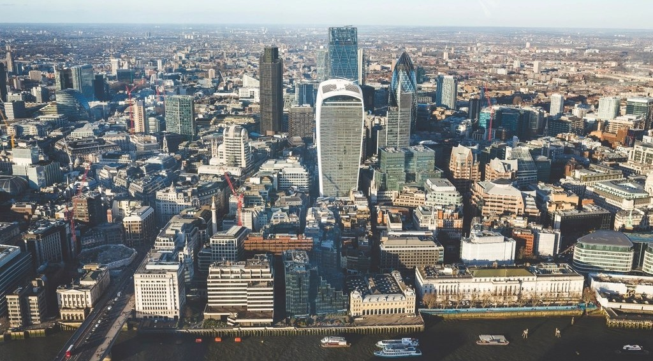
1. MEANING OF DEVELOPMENT
Activity 1
A city in a rich country.
Notes:
Activity 1. Look carefully at this picture: a city in a rich country. Observe every detail before I ask the question.

Slide 20
1. MEANING OF DEVELOPMENT
Activity 1: Question
Distinguish economic growth and development.
Notes:
Here is the question for Activity 1: Distinguish economic growth and development. Take one minute to think and write your answer in your rough notebook.

Slide 21
1. MEANING OF DEVELOPMENT
Activity 1: Answer
Growth is a rise in output; development is a better life for all people.
Notes:
Let us check the answer together. Growth is a rise in output; development is a better life for all people.

Slide 22
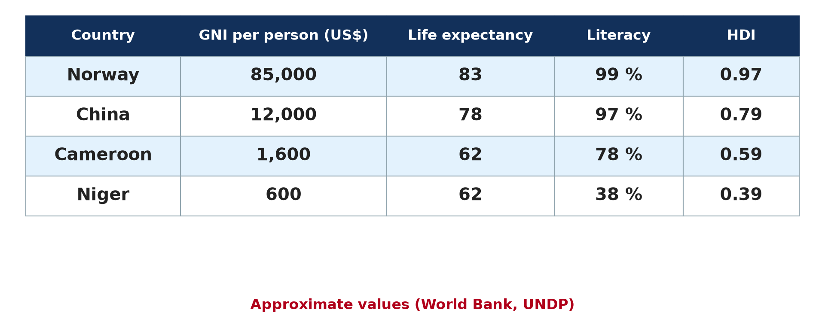
2. CRITERIA OF DEVELOPMENT
Activity 2
Development indicators (approximate).
Notes:
Activity 2. Look carefully at this diagram: development indicators (approximate). Observe every detail before I ask the question.

Slide 23
2. CRITERIA OF DEVELOPMENT
Activity 2: Question
Name two economic and two social criteria of development.
Notes:
Here is the question for Activity 2: Name two economic and two social criteria of development. Take one minute to think and write your answer in your rough notebook.

Slide 24
2. CRITERIA OF DEVELOPMENT
Activity 2: Answer
Economic: GNI per person, jobs. Social: life expectancy, literacy.
Notes:
Let us check the answer together. Economic: GNI per person, jobs. Social: life expectancy, literacy.

Slide 25
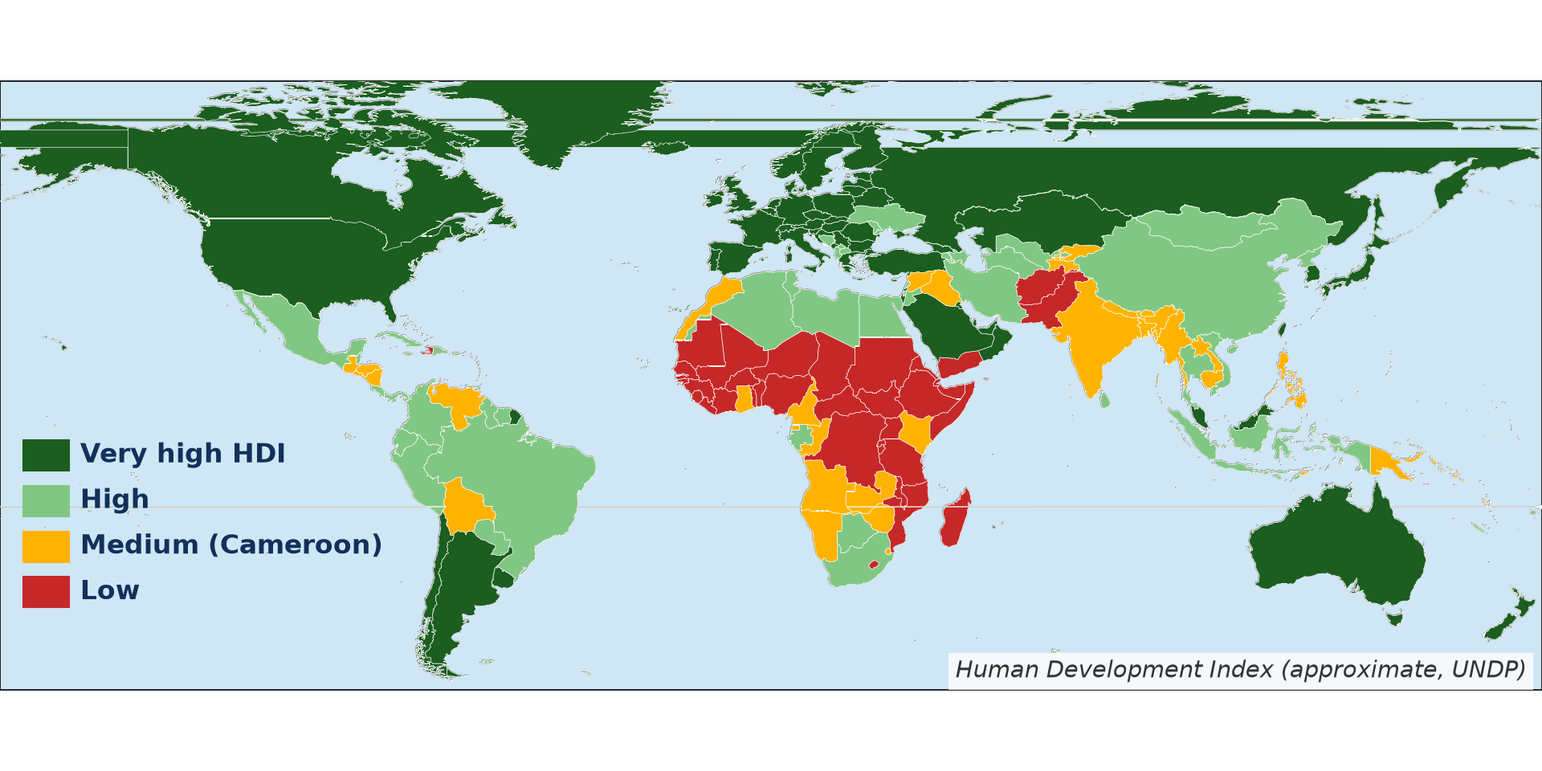
2. THE HDI
Activity 3
Human Development Index (approximate).
Notes:
Activity 3. Look carefully at this diagram: human Development Index (approximate). Observe every detail before I ask the question.

Slide 26
2. THE HDI
Activity 3: Question
Which region has most low-HDI countries?
Notes:
Here is the question for Activity 3: Which region has most low-HDI countries? Take one minute to think and write your answer in your rough notebook.

Slide 27
2. THE HDI
Activity 3: Answer
Sub-Saharan Africa.
Notes:
Let us check the answer together. Sub-Saharan Africa.

Slide 28

3. THE DEVELOPMENT GAP
Activity 4
A poor neighbourhood.
Notes:
Activity 4. Look carefully at this picture: a poor neighbourhood. Observe every detail before I ask the question.

Slide 29
3. THE DEVELOPMENT GAP
Activity 4: Question
Give three reasons for the gap between rich and poor countries.
Notes:
Here is the question for Activity 4: Give three reasons for the gap between rich and poor countries. Take one minute to think and write your answer in your rough notebook.

Slide 30
3. THE DEVELOPMENT GAP
Activity 4: Answer
Colonial history, unfair trade and debt (also poor governance, conflicts, climate).
Notes:
Let us check the answer together. Colonial history, unfair trade and debt (also poor governance, conflicts, climate).

Slide 31
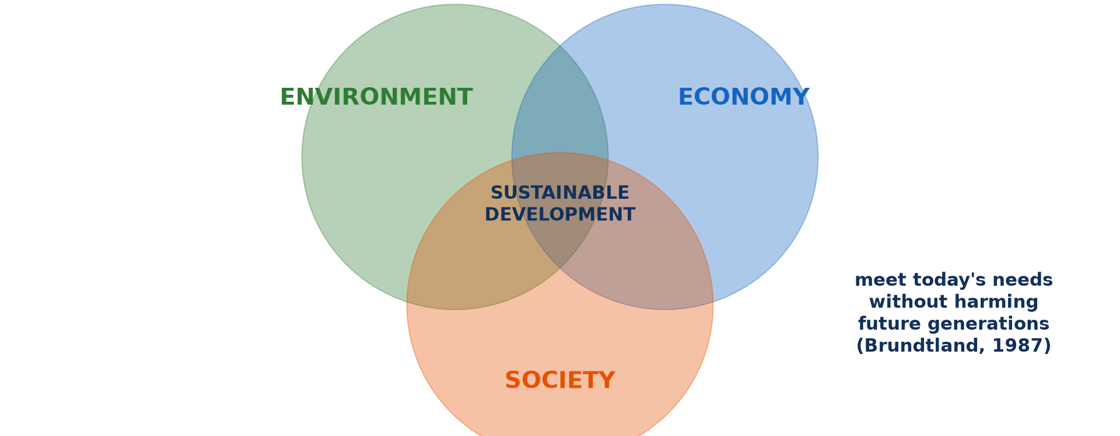
4. SUSTAINABLE DEVELOPMENT
Activity 5
The three pillars.
Notes:
Activity 5. Look carefully at this diagram: the three pillars. Observe every detail before I ask the question.

Slide 32
4. SUSTAINABLE DEVELOPMENT
Activity 5: Question
What is sustainable development?
Notes:
Here is the question for Activity 5: What is sustainable development? Take one minute to think and write your answer in your rough notebook.

Slide 33
4. SUSTAINABLE DEVELOPMENT
Activity 5: Answer
Development that meets today's needs without harming future generations.
Notes:
Let us check the answer together. Development that meets today's needs without harming future generations.

Slide 34
BOARD SUMMARY
Board Summary
Topic: Current Development Issues
Sub-topic: Concept of Development
Lesson 7: Notion of Development
Notes:
Now we are going to copy the board summary. Write the title and the headings neatly in your notebooks. I will give you enough time for each slide, so do not rush.

Slide 35
BOARD SUMMARY
1. Meaning of Development
Development and growth can be defined as follows:
Development: It is the improvement of people's living standards and wellbeing. It includes income, health, education and freedom.
Notes:
Let us copy Meaning of Development. Development and growth can be defined as follows. On this slide we have Development. Write each point on a new line, with the key term first, and explain it in your own words when we revise. When you finish, we go to the next slide.

Slide 36
BOARD SUMMARY
1. Meaning of Development (continued)
Economic growth: It is the increase in the goods and services produced by a country. It is measured by the rise in GDP or GNI.
Economic development: It is growth that also changes the structure of the economy, such as the move from farming to industry. It improves living conditions for many people.
Notes:
We continue with Meaning of Development. On this slide we have Economic growth and Economic development. Write each point on a new line, with the key term first, and explain it in your own words when we revise.

Slide 37
BOARD SUMMARY
2. Measuring and Classifying Development
Development is measured and countries are classified as follows:
Economic criteria: GNI per person, the share of jobs in industry and energy use measure wealth. They hide inequalities between rich and poor people.
Notes:
Let us copy Measuring and Classifying Development. Development is measured and countries are classified as follows. On this slide we have Economic criteria. Write each point on a new line, with the key term first, and explain it in your own words when we revise. When you finish, we go to the next slide.

Slide 38
BOARD SUMMARY
2. Measuring and Classifying Development (continued)
Social criteria and HDI: Life expectancy, literacy, doctors per person and access to water show wellbeing. The HDI combines income, health and education on a scale from 0 to 1.
Notes:
We continue with Measuring and Classifying Development. On this slide we have Social criteria and HDI. Write each point on a new line, with the key term first, and explain it in your own words when we revise. When you finish, we go to the next slide.

Slide 39
BOARD SUMMARY
2. Measuring and Classifying Development (continued)
Classification: Countries are grouped as MEDCs and LEDCs, or by income (high, middle, low). The World Bank and UNDP publish these groups every year.
Notes:
We continue with Measuring and Classifying Development. On this slide we have Classification. Write each point on a new line, with the key term first, and explain it in your own words when we revise.

Slide 40
BOARD SUMMARY
2. Measuring and Classifying Development
Illustration: development indicators (approximate)
Notes:
Now draw this illustration in your notebook: development indicators (approximate). Give it a title and label it clearly.

Slide 41
BOARD SUMMARY
3. The Development Gap
The gap between rich and poor countries has the following reasons:
Historical and economic reasons: Colonialism, unfair trade and debt keep many countries poor. They export cheap raw materials and import costly manufactured goods.
Notes:
Let us copy The Development Gap. The gap between rich and poor countries has the following reasons. On this slide we have Historical and economic reasons. Write each point on a new line, with the key term first, and explain it in your own words when we revise. When you finish, we go to the next slide.

Slide 42
BOARD SUMMARY
3. The Development Gap (continued)
Political and physical reasons: Poor governance, corruption and conflicts slow development. Droughts, diseases and landlocked positions also hold some countries back.
Notes:
We continue with The Development Gap. On this slide we have Political and physical reasons. Write each point on a new line, with the key term first, and explain it in your own words when we revise.

Slide 43
BOARD SUMMARY
3. The Development Gap
Illustration: Human Development Index (approximate)
Notes:
Now draw this illustration in your notebook: human Development Index (approximate). Give it a title and label it clearly.

Slide 44
BOARD SUMMARY
4. Sustainable Development
Sustainable development can be explained as follows:
Meaning: It is development that meets present needs without harming the ability of future generations to meet theirs. It balances the economy, society and the environment.
Notes:
Let us copy Sustainable Development. Sustainable development can be explained as follows. On this slide we have Meaning. Write each point on a new line, with the key term first, and explain it in your own words when we revise. When you finish, we go to the next slide.

Slide 45
BOARD SUMMARY
4. Sustainable Development (continued)
Ways to achieve it: Renewable energy, recycling and the protection of forests save resources. Education, good governance and fair trade help people to benefit from growth.
Notes:
We continue with Sustainable Development. On this slide we have Ways to achieve it. Write each point on a new line, with the key term first, and explain it in your own words when we revise.

Slide 46
BOARD SUMMARY
4. Sustainable Development
Illustration: the three pillars of sustainable development
Notes:
Now draw this illustration in your notebook: the three pillars of sustainable development. Give it a title and label it clearly.

Slide 47
FORMATIVE EVALUATION
Evaluation 1
Distinguish development and growth.
Notes:
Now let us check what you have understood. Question 1: Distinguish development and growth. Answer in your exercise book.

Slide 48
FORMATIVE EVALUATION
Expected Answer
Growth is more output; development is a better life for people.
Notes:
The expected answer is: growth is more output; development is a better life for people. If you got it right, well done.

Slide 49
FORMATIVE EVALUATION
Evaluation 2
Give three components of the HDI.
Notes:
Now let us check what you have understood. Question 2: Give three components of the HDI. Answer in your exercise book.

Slide 50
FORMATIVE EVALUATION
Expected Answer
Income, life expectancy and education.
Notes:
The expected answer is: income, life expectancy and education. If you got it right, well done.

Slide 51
REMEDIATION
Remediation
Fill in the blanks:
An index of income, health and education is the ______.
Cameroon has a ______ HDI.
Development that protects future generations is ______.
Notes:
For those who need more practice, fill in the blanks in your exercise book. The answers are: number 1, HDI; number 2, medium; number 3, sustainable.

Slide 52
HOMEWORK
Homework
Compare Cameroon with one African country using three development indicators.
Notes:
For your homework: Compare Cameroon with one African country using three development indicators. We shall correct it at the beginning of our next lesson.

Slide 53
NEXT LESSON
Next Lesson
Our next lesson will be on:
Lesson 8: Strategies of Development
Notes:
Our next lesson will be on Lesson 8: Strategies of Development. Thank you for your attention, and see you next time.

Slide 54
BILINGUAL GAME
Bilingual Game (Jeu Bilingue)
English | Français
Development | Le développement
Growth | La croissance
Income | Le revenu
Life expectancy | L'espérance de vie
Literacy | L'alphabétisation
Gap | L'écart
Notes:
Let us play the bilingual game. I say a word in English, and you give me the French word. Then we do the reverse.

Slide 55
LOGBOOK
Official Logbook (1/2)
Module / Topic | Current Development Issues
Lesson Title | Lesson 7: Notion of Development
Expected Learning Outcomes | Distinguish development and economic growth. Measure development with economic and social criteria. Explain the development gap and sustainable development.
Competence | Learners are able to measure development, explain the development gap and suggest ways to achieve sustainable development.
Notes:
I record this information in the official logbook of the class after the lesson.

Slide 56
LOGBOOK
Official Logbook (2/2)
Matter Taught | Meaning of Development; Measuring and Classifying Development; The Development Gap; Sustainable Development.
Evaluation | Formative evaluation and remediation exercise.
Homework | Compare Cameroon with one African country using three development indicators.
Enrolment / Present / Absent | ____ / ____ / ____
Achievement | To be completed after the lesson.
Notes:
I complete the second page of the logbook: the matter taught, the evaluation, the homework and the attendance.

Slide 57
TEACHER'S NOTE
Teacher's Note
Timing: Homework correction, plan, objectives 8 min | Recall, situation, action 10 min | 5 activities 30 min | Board summary (copying) 30 min | Evaluation, remediation 10 min | Homework, next lesson 5 min | Logbook 7 min
Without the projector (Activity 1): give examples.
Without the projector (Activity 2): read the table.
Without the projector (Activity 3): read the map.
Without the projector (Activity 4): discuss reasons.
Without the projector (Activity 5): explain the circles.
Notes:
This slide is for me, the teacher: it gives the timing of the lesson and what to do if the projector is not available.

Slide 58
REFERENCES
References
National Geography Syllabus, MINESEC/IGE/IP-SS, 2019 — Module 7 (Environment and Development).
Photo, Activity 1: “Aerial View City Skyline Skyscraper” by unknown, CC0 1.0, via rawpixel (https://www.rawpixel.com/image/5967710/aerial-view-city-skyline-skyscraper)
Photo, Activity 4: “Mathare” by Book Aid International, CC BY-NC-ND 2.0, via Flickr (https://www.flickr.com/photos/45024905@N07/4135561707)
Diagrams and animations: drawn for this lesson (Geography Department).
Notes:
These are the references and picture credits used to prepare this lesson.

